Slide 1
Car Evaluation Model
Classification using KNN (K-Nearest Neighbour) Algorithm

Slide 2
Objective
Using Car Evaluation Data Set build a model for assessing cars by performing classification in R and Python.
For obtaining this classification KNN (K-Nearest Neighbours) supervised algorithm is used.
Compare the results (accuracy) between R and Python.

Slide 3
About Data Set
Class Values:
unacc, acc, good, vgood
Attributes:
buying: vhigh, high, med, low.
maint: vhigh, high, med, low.
doors: 2, 3, 4, 5more.
persons: 2, 4, more.
lug_boot: small, med, big.
safety: low, med, high.
http://archive.ics.uci.edu/ml/datasets/Car+Evaluation

Slide 4

Changes in Data Set
Class Values:
Unacceptable, Acceptable, Good, Very-Good
Attributes:
Buying-Price: 4, 3, 2, 1.
Maint-Price: 4, 3, 2, 1.
Door-Numbers: 2, 3, 4, 5.
Total-Persons: 2, 4, 5.
Lug_Boot: 1, 2, 3.
Safety: 1, 2, 3.

Slide 5
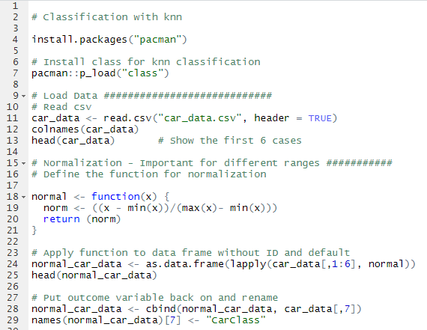
Implementation using R

Slide 6
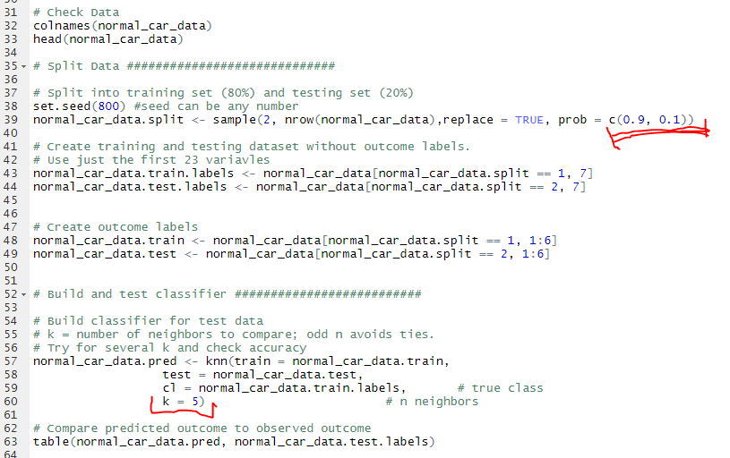
Implementation using R

Slide 7

Output
Total trained: 1559 data (90%)
Total tested: 169 data (10%)
Accuracy: 97.63%

Slide 8
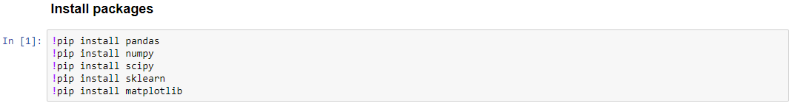
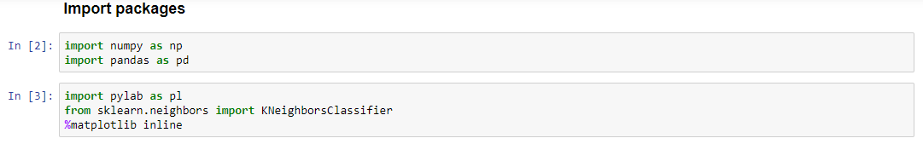
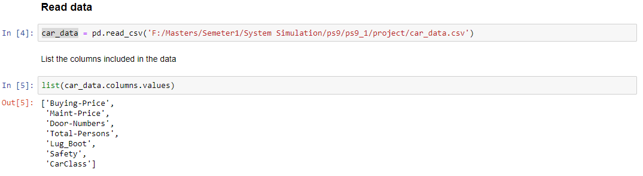
Implementation using Python

Slide 9
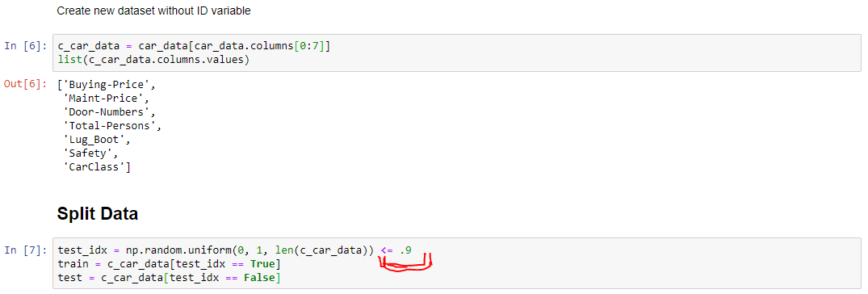
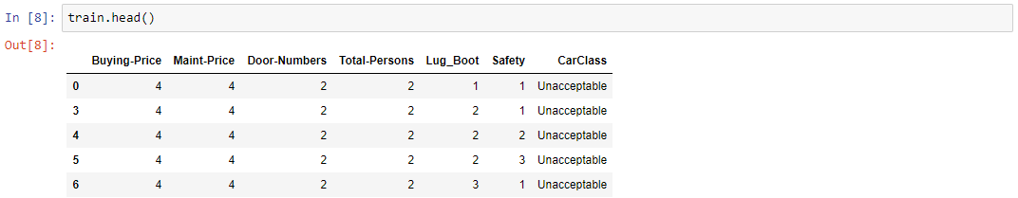
Implementation using Python

Slide 10
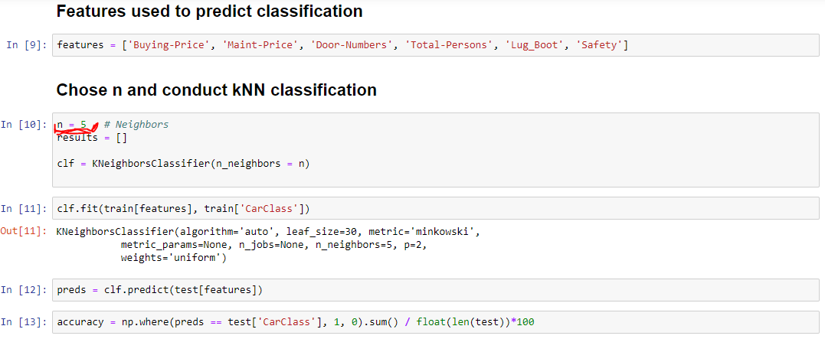
Implementation using Python

Slide 11
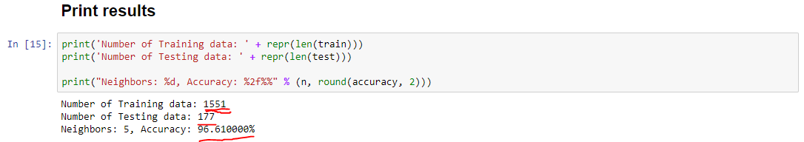
Output

Slide 12
Pros and Cons of KNN
Advantages:
K-NN is pretty intuitive and simple
Effective if the training data is large
Very easy to implement for multi-class problem
Disadvantages:
K-NN slow algorithm
Imbalanced data causes problems
Optimal number of neighbors

Slide 13


Slide 14


